Slide 1
Neural Architecture Search
Sohan Mahesh &
Bhalchandra Shinde

Slide 2
What is NAS
Definition: Neural Architecture Search (NAS) is a machine learning approach to design machine learning models automatically
Input: Search space of possible architectures, Output: Best-performing neural network model
NAS has evolved from expensive, brute-force neural design to efficient, scalable, and hardware aware architecture discovery powering real world AI systems.
Normally a human researcher decides
  How many layers a model should have
  What type of layers (convolutional, recurrent, transformer, etc.)
  Hyperparameters like filter size, stride, etc.
NAS uses machine learning to design machine learning models, it searches through many possible architectures and finds the one that performs best on your dataset
Notes:
NAS accomplishes automated neural architecture selection by performing exhaustive searches through architecture alternatives to identify structures which best match pre-defined performance metrics.
Autonomous algorithms through Neural Architecture Search discover the optimal neural network design for specific tasks. Typical model design requires extensive testing and significant human experience for choosing correct layers alongside connection structures and hyperparameter values. Structured searches in the vast architecture space enables NAS to automatically pick the most effective network design according to predefined performance specifications like accuracy and latency with computational efficiency.

Slide 3
HOW NAS Works
Search Space
Search Strategy
Performance Evaluation
Optimal Architecture
Search Architecture
Performance Evaluation
Search Space
Search method/ strategy
Good Enough
Optimal Architecture
NO
Notes:
By automating this process, NAS reduces the time and resources required to develop cutting-edge AI models.
Search Space - It defines the range of possible neural network configurations, including layer types, connections, and activation functions.
e.g., CNN, RNN, Transformer variants
Search strategy - Algorithm that explores the space.
e.g. Reinforcement Learning, Evolutionary Algorithms, or Gradient-based methods
Performance evaluation - Evaluates each candidate architecture (by training and testing accuracy, loss, latency, etc)

Slide 4
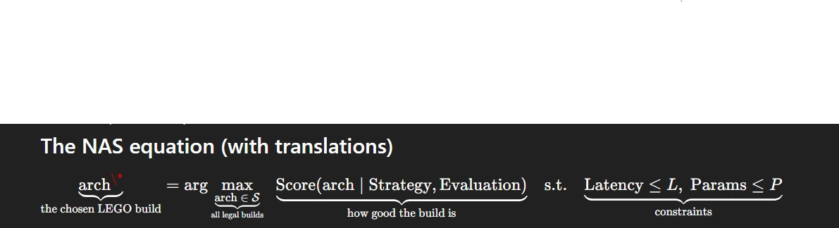
NAS Equation

Slide 5
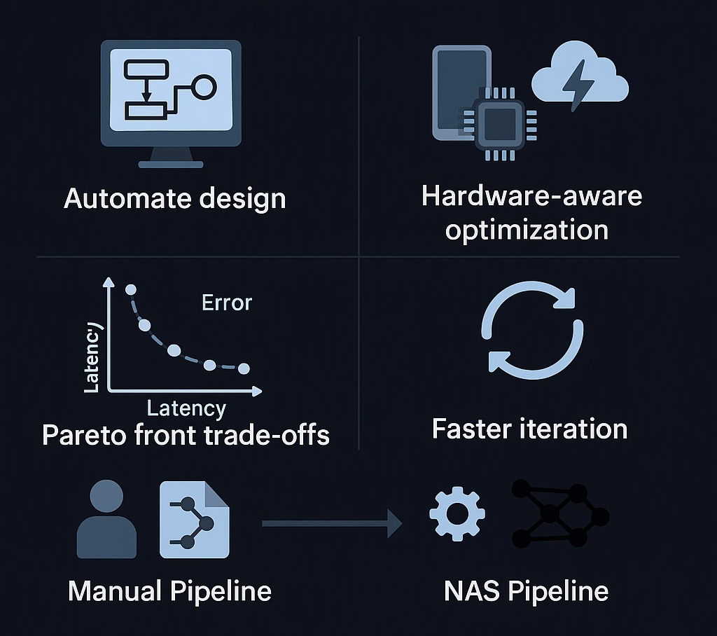
Why NAS?
Resource requirement
Design process
Exploration
Speed
Bias
Adaptability
Performance
Notes:
Tensor Processing Units – Custom unit added by Google for ML
Traditional model design is trial-and-error and heavily relies on human experience.
NAS automates this, searching thousands of architectures quickly and objectively.
Smart proxy evaluations and weight sharing now allow results in hours instead of weeks.
NAS can even design smaller, faster models for deployment on mobile devices.
While early NAS methods (like NASNet) required thousands of GPU-hours, newer techniques (like DARTS, AutoKeras) make NAS accessible to students and small teams.
Emphasize that NAS is not replacing humans, it’s augmenting them by automating repetitive trial phases.

Slide 6
Search Space Design
The search space specifies which components the NAS algorithm can vary:
Layer type - Conv2D, LSTM, Transformer, Dense
Number of layers - Depth of the network (e.g., 5–50 layers)
Kernel size/ filter size - 3×3, 5×5, 7×7
Activation function - ReLU, GELU, Tanh, Sigmoid
Connections - Skip connections, residual links
Pooling type - MaxPool, AvgPool, GlobalPool
Width/channels - 32, 64, 128 filters
Normalization - BatchNorm, LayerNorm
Search Space Type | Description | Example
Global Search Space | NAS can modify the entire architecture (input to output). | Early NASNet (2017)
Cell-based Search Space | NAS finds the best cell/block structure and repeats it to build the full model. | ENAS, DARTS
Hierarchical Search Space | Combines cells into higher-level modules. | NASNet, EfficientNet
Macro vs Micro Search Space | Macro: overall network topology. Micro: inner structure of a repeating cell. | EfficientNet (micro)

Slide 7
Search Strategies
Strategy | Key Idea | Example | Pros | Cons
Reinforcement Learning | Controller learns to generate architectures | NASNet | High accuracy | High cost
Evolutionary | Evolving architectures over many generations | AmoebaNet | Parallel, robust | Slow
Bayesian Optimization | Predicts good architectures using probabilistic models | SMBO | Efficient | Small spaces
Gradient-based | Continuous relaxation of discrete choices | DARTS | Fast, elegant | Can be unstable
Random Search | Simple sampling baseline | RSWS | Simple | Inefficient
One-shot / Weight-sharing | Supernet trains all candidates jointly | ENAS, OFA | Fastest, Reduced cost | May be biased
Notes:
Use this as a map; then dive one slide per method.

Slide 8
Performance Estimation
Method | Description | Speed | Accuracy | Example
Full Training | Train every model fully | Very Slow | High | NASNet
Early Stopping | Stop early & extrapolate | Medium | Medium | Learning curve models
Low-Fidelity Proxy | Small dataset/resolution | Fast | Medium | Proxy NAS
Weight Sharing | Shared supernet weights | Very Fast | Medium | ENAS, OFA
Surrogate Model | Learn predictor of performance | Very Fast | Depends | NAS-Bench
Zero-Cost Estimators | No training, use metrics | Fastest | Lower | SynFlow, NASWOT
Goals of Performance Estimation
A good estimation strategy should:
Predict architecture quality accurately
Be fast to compute
Support fair comparison among candidates
Avoid bias (not favoring certain architectures unfairly)

Slide 9
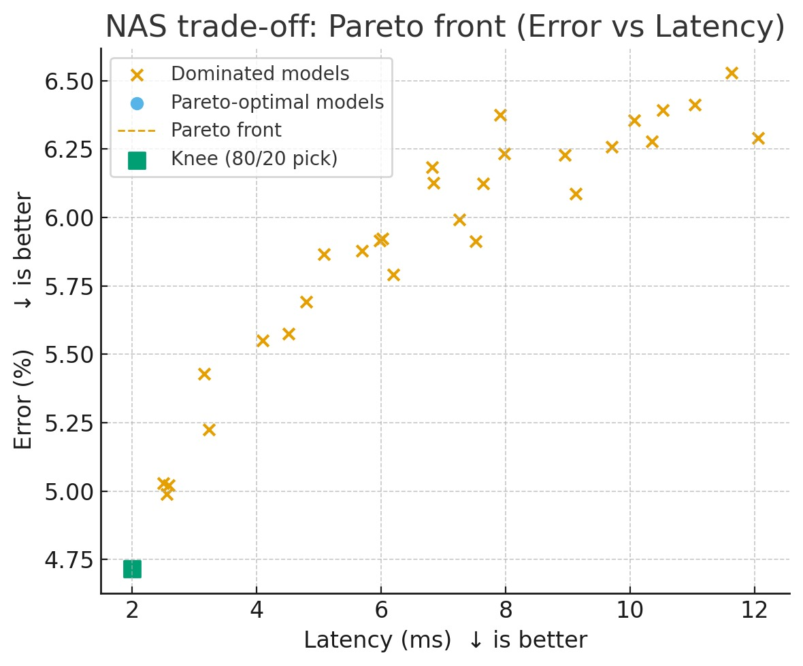
PArETO front IN Optimization
Pareto-optimal (NAS): No other model is better on one goal *without* being worse on another.
Pareto front: The set of these best trade-offs; choose a point (often the knee) that fits your accuracy and speed limits.
Objective directions: accuracy ↑, latency ↓, params ↓
Models:
A: accuracy 78.0%, latency 3.5 ms, params 5.0M
B: accuracy 80.0%, latency 5.0 ms, params 3.0M
C: accuracy 79.0%, latency 3.2 ms, params 4.5M
Dominance: C dominates A (higher accuracy, lower latency, fewer params).
Pareto front: {B, C}. A is dominated and excluded.
Notes:
Vilfredo Pareto was an Italian economist who observed that roughly 80% of the land in Italy was owned by 20% of the population, a principle extended to show that a small percentage of inputs often leads to a large percentage of outputs. This is known as the Pareto Principle or the 80/20 Rule and is applied in many fields to understand that 80% of results come from 20% of efforts
In multi-objective optimization (like Neural Architecture Search), there’s often more than one goal:
Maximize accuracy
Minimize latency (speed)
Minimize model size or power use
You can’t always improve one without hurting another — this is where the Pareto frontier (or Pareto-optimal set) comes in.
A solution is Pareto optimal if you can’t improve one objective without worsening at least one other.
Pareto-optimal architecture: A model for which no other candidate improves at least one objective (e.g., accuracy) without worsening another (e.g., latency, params, energy).Pareto front: The set of all non-dominated architectures—i.e., the best trade-offs across the chosen objectives.In NAS: Search returns a Pareto front over {accuracy↑, latency↓, params↓, energy↓}; deployment picks a point on this front (often the knee) that fits hardware and quality targets.

Slide 10
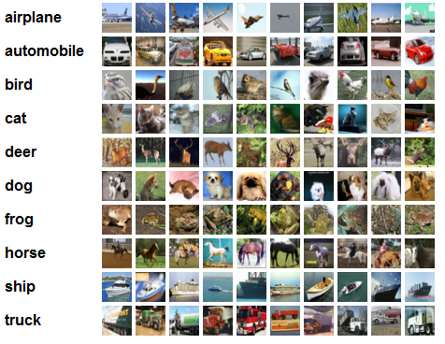
NAS in Action (Example)
Google’s NASNet (2017) was one of the first big breakthroughs.
Manual CNNs (like ResNet or Inception) took months or years of human tuning.
NASNet, discovered automatically using reinforcement learning, achieved better accuracy with fewer parameters.
Model | Accuracy (Top-1, ImageNet) | Parameters
Inception-v3 | ~78% | 24M
NASNet-A | ~82.7% | 5.3M

Slide 11
Advantages and challenges
Advantages
Automation | Eliminates manual architecture tuning
Performance | Finds better-performing models
Adaptability | Customizes models for hardware constraints
Scalability | Works across domains and datasets
Challenges
High Compute Cost | High training time and GPU usage. Search across many models is expensive.
Search Space Explosion | Too many possible architectures. The number of possible layer combinations grows exponentially
Evaluation Bottleneck | Training every candidate is slow
Reproducibility | Hard to reproduce results, Results vary across runs and hardware
Notes:
Advantages-
Automation: NAS replaces manual model engineering with algorithmic search — saving researchers weeks or months.
Performance: Models found by NAS (like NASNet, EfficientNet) have achieved state-of-the-art results in image recognition.
Adaptability: NAS can optimize for multiple goals — accuracy, latency, energy efficiency — making it ideal for devices with limited power or memory.
Scalability: The same NAS framework can be applied to vision, text, or speech tasks with minimal human intervention.
Overall, NAS represents a major step toward self-optimizing AI systems that can adapt automatically to new problems.

Slide 12
NAS Frameworks
Framework | Best Use Case | Search Strategy | Highlights / When to Use | Example Projects
AutoKeras (Google / Keras Team) | Easy-to-use NAS for images, text, tabular data | Bayesian + Hyperband | Great for beginners or quick experimentation. Integrates with TensorFlow/Keras | MNIST, CIFAR-10, small datasets
NNI (Microsoft) | General AutoML & NAS across frameworks | RL, evolutionary, TPE, DARTS | Flexible, supports PyTorch, TF, Scikit-learn; useful for research and industry pipelines. | Custom NAS + hyperparameter tuning
KerasTuner (Google) | Lightweight NAS-like hyperparameter search | Random, Bayesian, Hyperband | For smaller search spaces; integrates seamlessly with TensorFlow/Keras. | Architecture/hyperparameter optimization
DARTS (Differentiable NAS) | Gradient-based NAS research | Gradient optimization | Fast and memory-efficient for research; good for custom search-space experiments. | Academic benchmarks
ENAS (Efficient NAS) | Fast NAS via weight sharing | Reinforcement Learning + shared supernet | For constrained compute environments; low-cost exploration. | Edge & mobile model search
FBNet (Facebook / Meta) | Hardware-aware NAS | Differentiable + latency-optimized | When optimizing for specific hardware (mobile CPU/GPU). | Edge deployment, mobile AI
Vertex AI NAS (Google Cloud) | Enterprise-scale NAS | Proprietary (multi-objective, hardware-aware) | For production ML teams needing scalable cloud-based NAS. | Industry / deployment-ready NAS

Slide 13
Thank You

